Slide 1
Overview of Continuous Water-Quality Monitoring
Notes:
Today I’m going to be addressing topics related to continuous water quality monitoring
First describe what is meant by CWQM vs discrete monitoring

Slide 2
Purpose of Monitoring
Define the objectives of the water quality monitoring project
  Environmental impacts of effluent
  Contaminant alerts
  Plume tracking
  Trends
Notes:
Establishing the objectives of monitoring is the first step

Slide 3
How will data be used ?
  Investigate variations in water quality
    Event
    Diurnal
    Monthly
    Seasonal
    Annual
  Evaluate loads (requires flows)
  Regulations (daily mean, max, min)
  Threshold warnings
  Development of surrogate relations

Slide 4
Design of Monitoring Plan
Data requirements
  Period and duration
    Seasonal
    Short term
    Long-term
  Frequency of data collection
    Continuous or discrete
    15 minute, hourly, daily, monthly, etc…
  Sensor selection
Notes:
Once the objectives are established the monitoring plan can be designed to achieve the intended goals

Slide 5
Water-Quality Parameters
Common parameters measured:
  Temperature
  Specific conductance
  Salinity (based on specific conductance)
  pH
  Dissolved oxygen
  Turbidity

Slide 6
Typical Probe Specifications
Maximum depth: 60 m
Temperature: -5 to 50º Celsius
Specific conductance: 0 to 100 mS/cm
Salinity: 0 to 80 ppt
pH: 0 – 14 pH units
Dissolved oxygen: 0 to 50 mg/L, 0 to 500 % saturation
Turbidity: 0 to 1,000 NTU

Slide 7
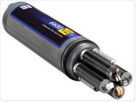

Water-Quality Sensors
YSI

Slide 8
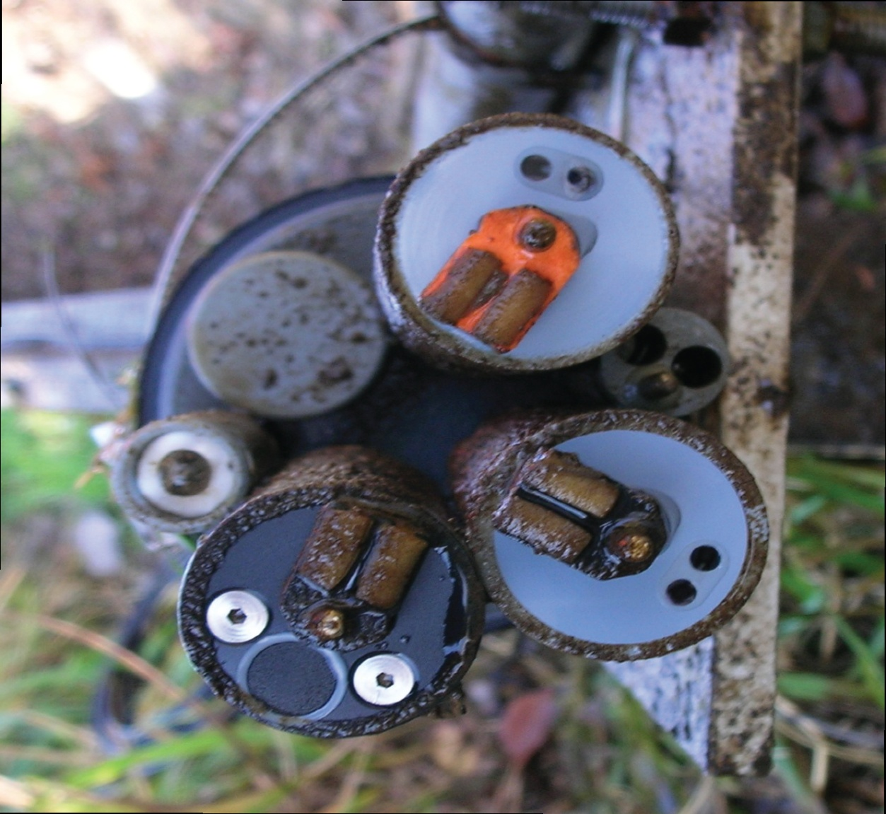
Chlorophyll-a (algae)
pH
Temperature and Specific Conductance
Optical
Dissolved Oxygen
Turbidity

Slide 9
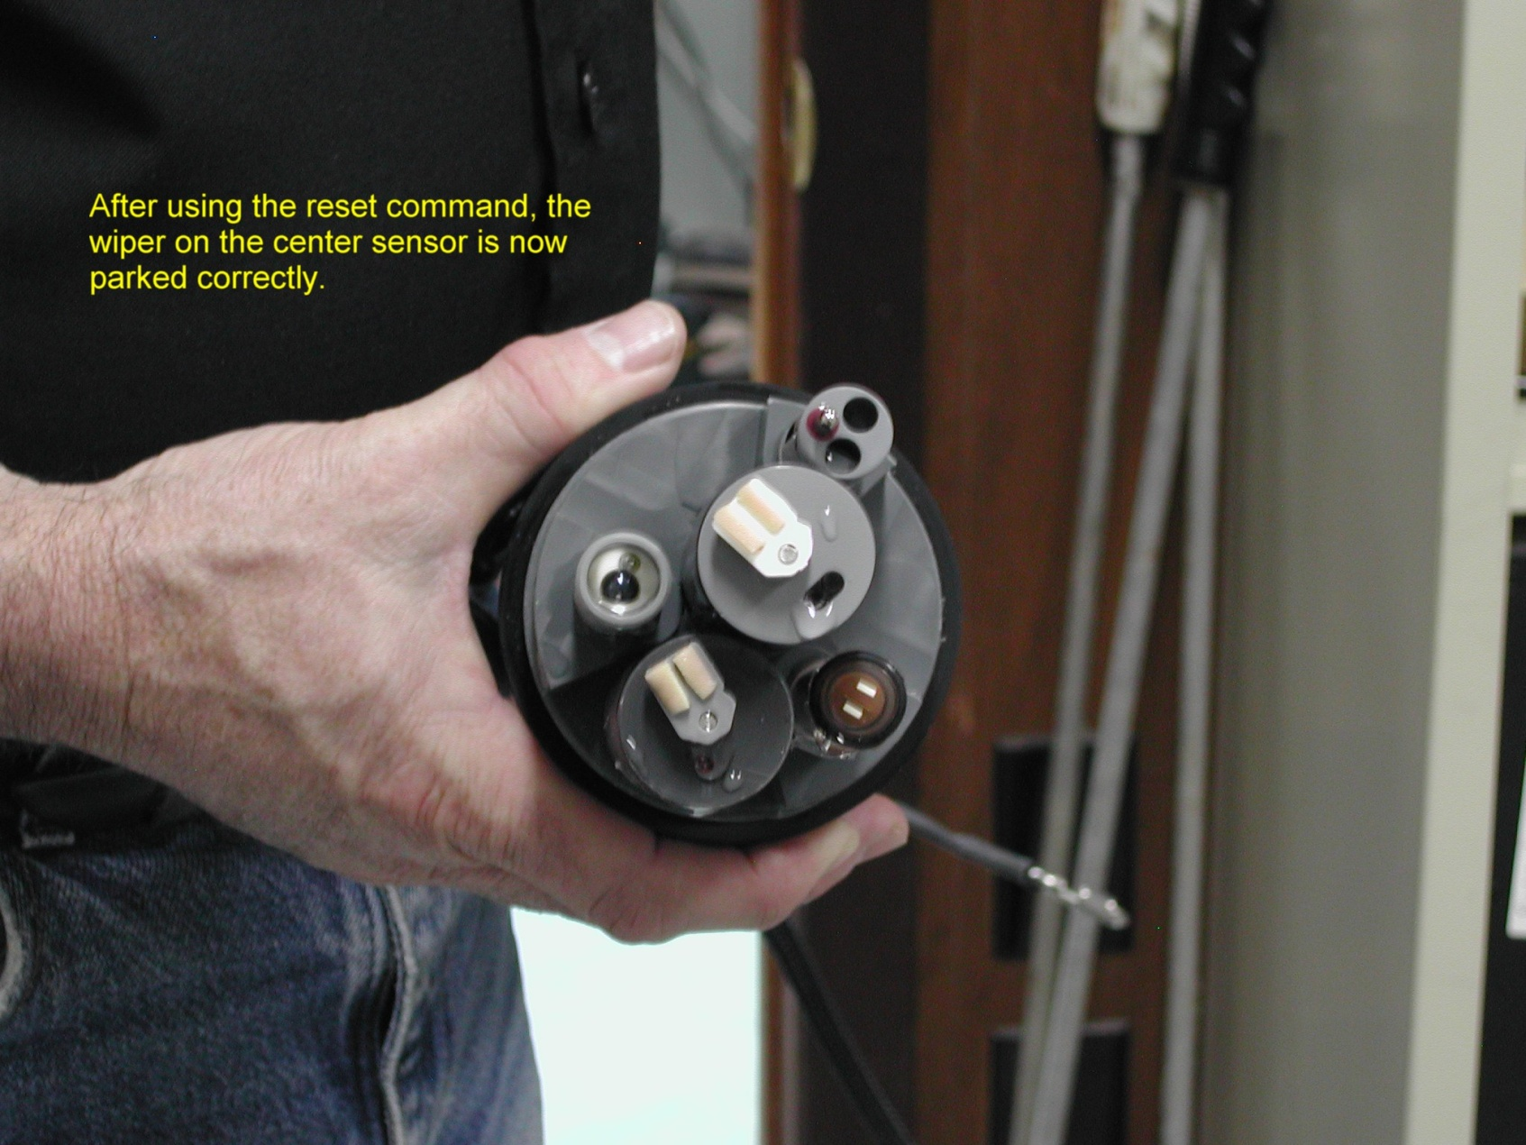
Clark Cell
Dissolved Oxygen

Slide 10
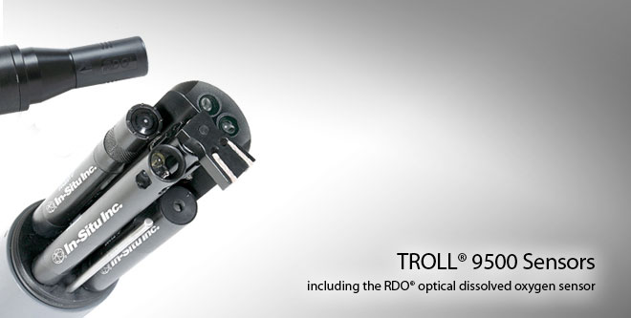
Other Sensors
Troll

Slide 11
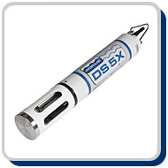
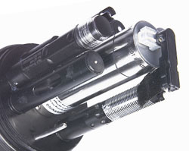
Other Sensors
Hydrolab

Slide 12
Temperature
Thermistor
Resistance changes with temperature
Resistance converted to temperature using algorithm
Common unit: degrees Celsius

Slide 13
Specific Conductance
Measure of the water’s ability to conduct electrical current
Electrodes must be submerged in water
Approximate measure of the amount of dissolved solids or ions in water
Specific conductance is conductance “normalized” to 25 degrees C
Common unit: uS/cm (microSiemens per centimeter), also umhos/cm (same units)
Notes:
Current flow through electrodes and sample

Slide 14
Salinity
Not measured directly
Computed parameter based on conductivity and temperature
Essentially measuring the amount of chloride in water
Common unit: ppt (parts per thousand)

Slide 15
pH
Measure of acid/base characteristics
pH 7.0 = neutral
pH > 7.0 = alkaline/basic
pH < 7.0 = acidic
Measures differential of hydrogen ions (H+) inside/outside of electrode
Common unit: standard pH units

Slide 16
Dissolved Oxygen
2 major types
  Rapid pulse Clark cell
  Optical
Common units: mg/L and % saturation

Slide 17
Advantages of Optical Sensors
Less susceptible to FOULING
Less susceptible to CALIBRATION DRIFT
Sensors require fewer site visits
Still need routine cleaning
Notes:
BASED ON OWSC TESTING
Less susceptible to fouling because no oxygen is consumed.
Less susceptible to calibration drift because there is no electrochemical reaction that causes probe behavior to change.
Still need to worry about micro environments when the probe may become isolated from the environment that we are trying to measure.
More rugged in that it is much more difficult to damage the probe by hitting it with the sensor guard or aquatic bugs from puncturing holes in the membrane.
Clark cells are dependent upon rate
of O₂ transfer
Optical sensors do not consume oxygen

Slide 18
Advantages of Optical Sensors, cont.
More rugged
Greater range of operation
More accurate readings at low DO
No need for stirring
Not strongly affected by temperature
Notes:
Optical Sensor:
0-50 mg/L of operational range for the optical sensor.
0-20 mg/L +-.1 mg/L or 1% of reading, whichever is greater.
20 – 50 mg/L +- 15%
Clark Cell Sensor
0-20 mg/L is 0.2 mg/L or 2%, whichever is greater.
20-50 mg/L is +- 6% of reading

Slide 19
Turbidity
Measure of water clarity
Light is emitted, scatters off particles
Amount of light scattered at 90 degrees is measured
Common units (depends on probe):
  NTU (nephelometric turbidity units)
  FNU (formazin turbidity units)

Slide 20
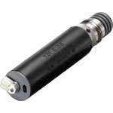

Turbidity
Light source
Sample
Detector measures how much light is scattered at 90 degrees
Photo courtesy of Sontek YSI Inc.
Detector

Slide 21
Design of Monitoring Plan
Installation type
  Flow through
  In situ
    internal logger and power
    external logger and power
Notes:
Once the objectives are established the monitoring plan can be designed to achieve the intended goals

Slide 22
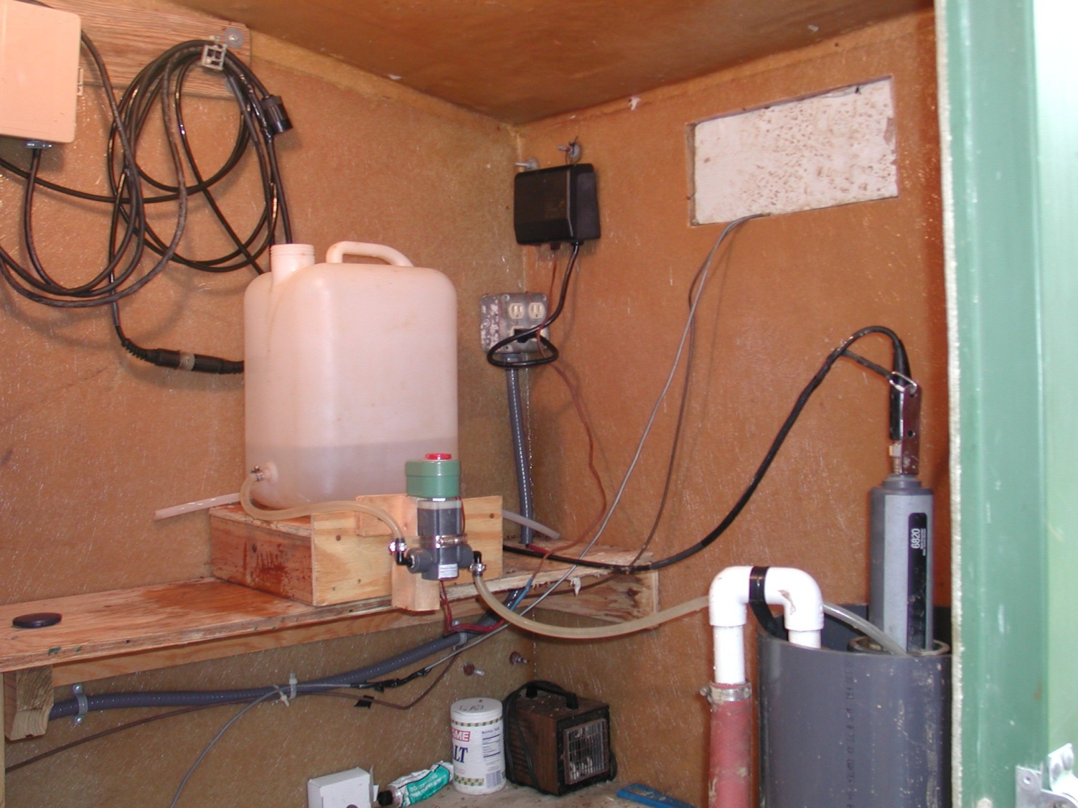
Flow through system
Water from river outlet
Notes:
Slide 75

Slide 23
Flow through
Advantages
  Secure
  Reduced fouling
  Real-time data access
Disadvantages
  Requires AC electric service
  More maintenance
  Results can be less accurate (turbidity)

Slide 24
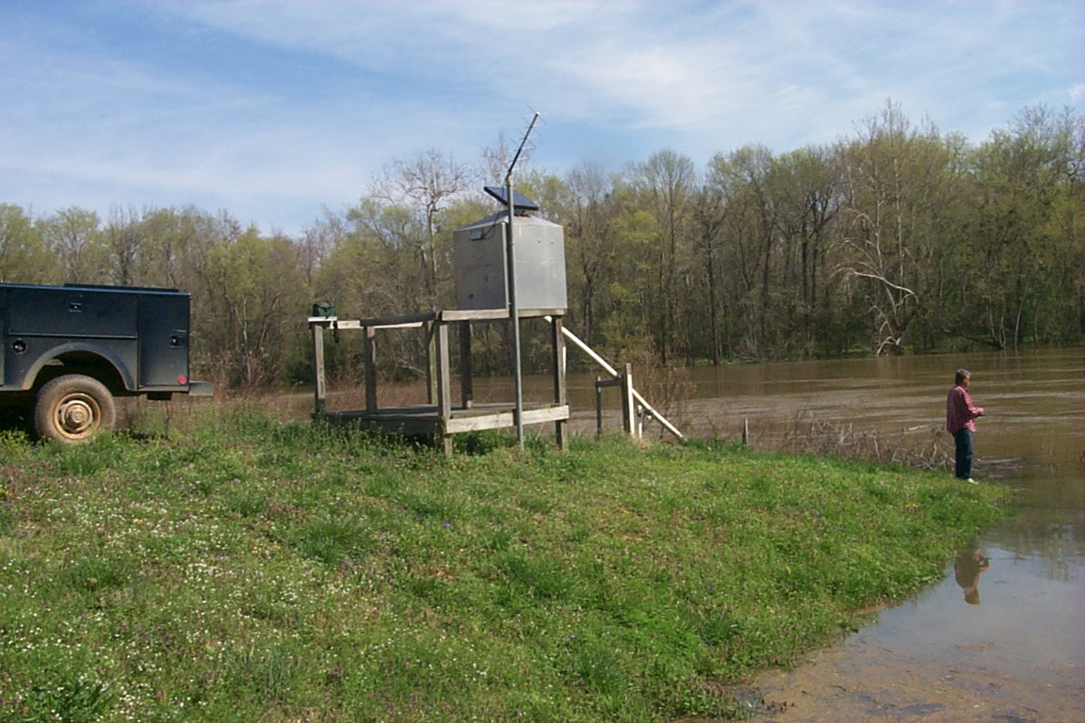
In situ (external logger)

Slide 25
In situ (external logger)
Advantages
  Data are secure
  Real-time data access
  Instream monitoring often yields more accurate results
  No AC requirement permits remote sites
Disadvantages
  Sonde and probes are vulnerable to vandalism and loss
  Probes are subject to fouling and damage from debris

Slide 26
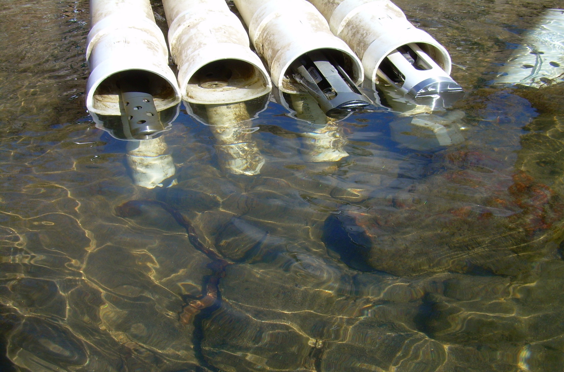
In situ (internal logger)

Slide 27
In situ (internal logger)
Advantages
  Remote locations possible
  Instream monitoring often yields more accurate results
  Less maintenance
Disadvantages
  Telemetry not an option
  Sonde, probes, and data are vulnerable to vandalism and loss
  Probes are subject to fouling and damage from debris

Slide 28
Continuous Water Quality Monitoring
Advantages
Disadvantages
Needed in rapidly changing systems
Provides better understanding of interaction between constituents
Provides better understanding of transport processes
Equipment costs are greater
Operation and maintenance costs are greater
Vulnerable to damage and/or loss

Slide 29
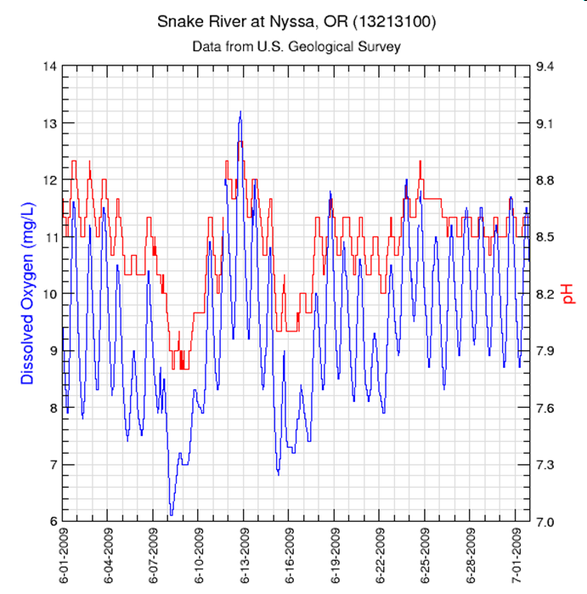
Relations Between Parameters
DO and pH
DO and pH track together
Diurnal Pattern
Why?
Aquatic organisms produce CO2 at night combining with H20 to form H2CO3 (carbonic acid) causing pH to go down.
Notes:
DO goes up during the day when biological productivity is high
DO drops off at night when aquatic organisms are using DO and respiring CO2
CO2 combines with H20 to form H2CO3 or carbonic acid
The increased carbonic acid causes pH to go down at night.
Thus there is a direct relation between DO and pH with a strong diurnal cycle
Collecting continuous QW data allows you to better observe these types of relations which leads to a better understanding of physical processes and the interacton of constituents

Slide 30
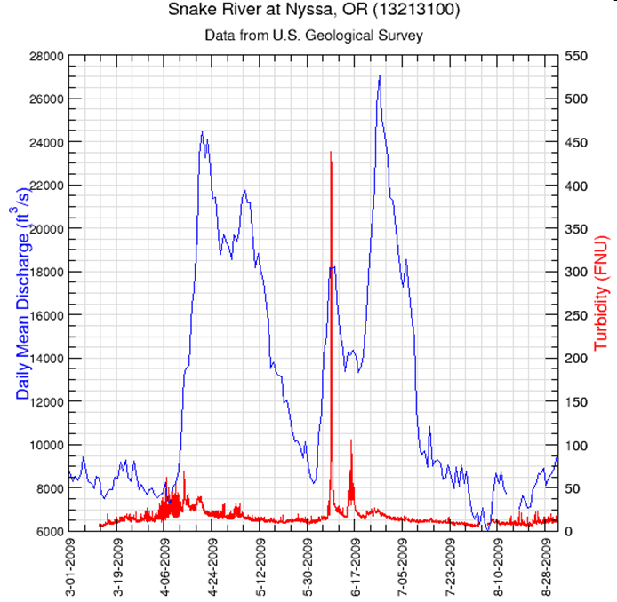
Relations Between Parameters
Turbidity –vs- Discharge
Notes:
This slide shows the relation between turbidity and streamflow.
Turbidity is a good surrogate for suspended sediment or TSS
In a natural stream you often see a first flush of sediment during the high flows that occur after a long period of low flow. (snowmelt in ID)
After this flush the sediment concentrations are often lower even during a higher flow event.

Slide 31
Discrete vs Continuous Monitoring
Notes:
In this slide we have 4 types of data shown
Streamflow (cfs)
Suspended sediment concentration (mg/l) from discrete samples
LOADEST model results which are estimates of the sediment load based on streamflow and discrete samples
Continuous suspended sediment concentrations from an Acoustic Backscatter signal (similar to turbidity)
This illustrates the disadvantage of using only a few discrete samples, even when coupled with flow, to estimate instantaneous or even daily loads.

Slide 32
Other Surrogate Possibilities
Continuous Parameter(s) | Surrogate Constituent
Specific Conductance | TDS, Total Nitrogen
Turbidity | Suspended Sediment, Total Phosphorous
Turbidity + Temperature | Bacteria
Relations are developed using discrete samples and linear regression
Regression model used to synthesize continuous record of target parameters that are difficult to monitor.
Parameter -vs- surrogate relations are not universal but site specific

Slide 33
Applications
Continuous monitoring the constituent or its surrogate to aid in identifying occurrence and duration of water-quality parameters that exceed regulatory limits.

Slide 34
Relation between SC and TN

Slide 35
Applications (cont)
Identify and optimize periods for sample collection
Quantify constituent loads (volume/time)
Familiarity with the site and data will lead to a better understanding of physical processes and interactions between constituents

Slide 36
Questions?

